Slide 1
Climate Change project update: week 5
Rens Breunissen,
Lotte van Dongen,
Markus Peschl,
Cecilia Casolo,
Maaike Elgersma,
Eva Slingerland,
Simon van Oosterom
Supervised by
Lorinc Meszaros [Deltares]
Robbert Fokkink [TU Delft]
Mathematical Data Science

Slide 2
Github
We used a Github drive in order to share codes and results. You can join the drive and view our progress with the following link:

Slide 3
This week we worked on:
Finishing the research on clustering and Neural Networks
Writing the report

Slide 4
Clustering
We finished a verification measure for the number of clusters
We Generated the clusters for all different models, stations, and scenarios
Finally, we combined this with the code that analyzes the changes between the early and late years

Slide 5
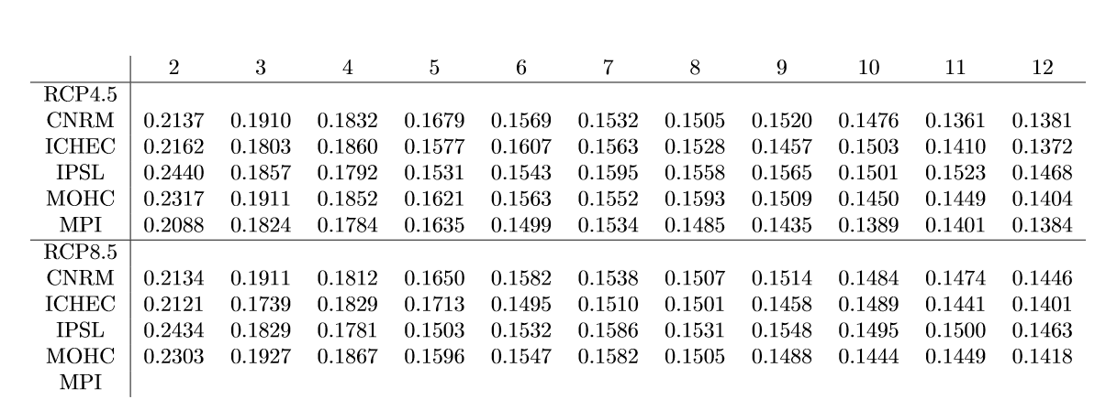
Validating the clusters
The number of clusters that we have used (often either 2 or 4) had been chosen on intuition.
However, the quality of the clusters can be numerically expressed with validation methods (we used the silhouette score where higher => better).
One can observe that there is a steep drop from 2 to 3 clusters and from 4 to 5 clusters. However, in general, the silhouette score decreases when we increase the number of clusters.
However, we feel that 2 clusters hides to much of the information, so we used more.

Slide 6
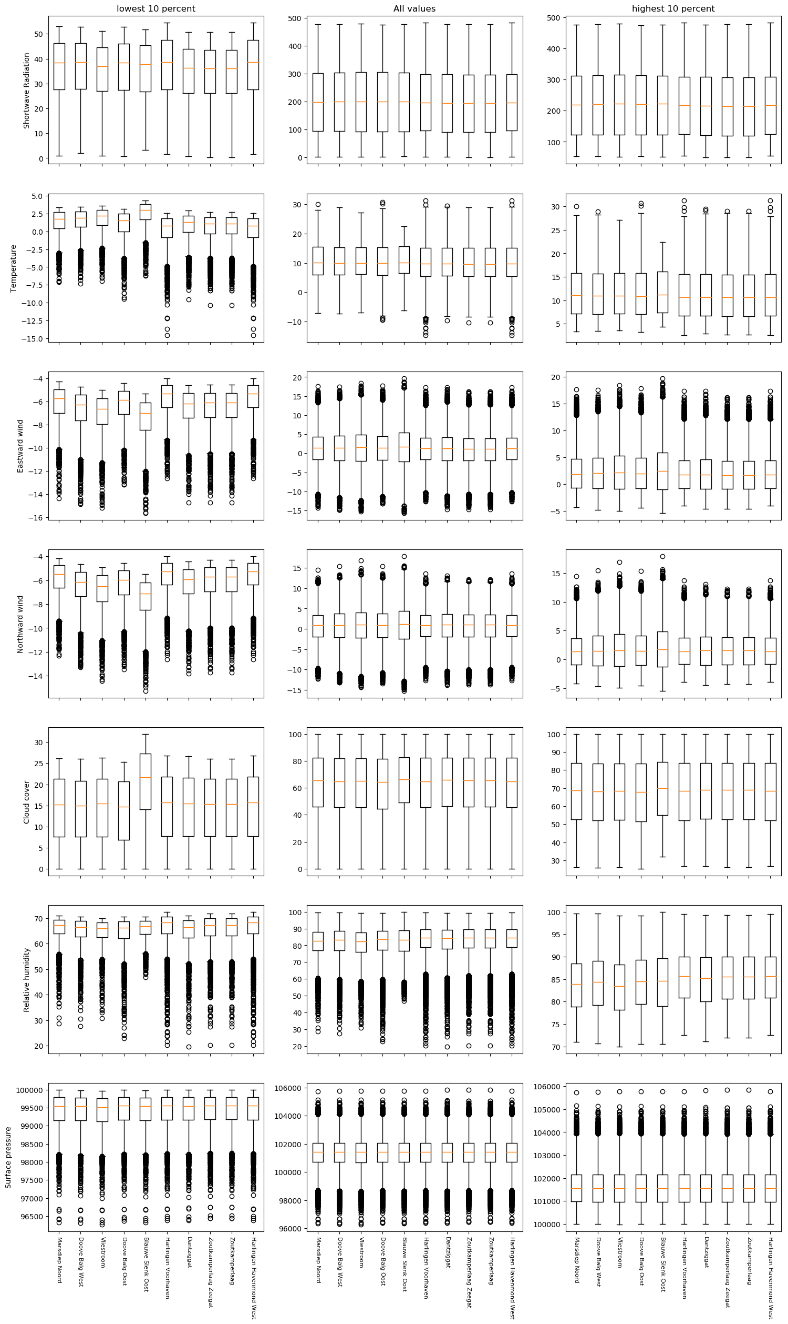
Comparing the stations
Secondly, we created the following charts which summarize all of the data from all stations for one model and one scenario.
We are going to use it in the pre-analysis in the report in order to point out what the interesting cases are .
One word of warning, it is rather big and definitely won’t be used in the final presentation.
Each row represents a variable, the left and right column are the extreme days (highest and lowest 10 %)

Slide 7
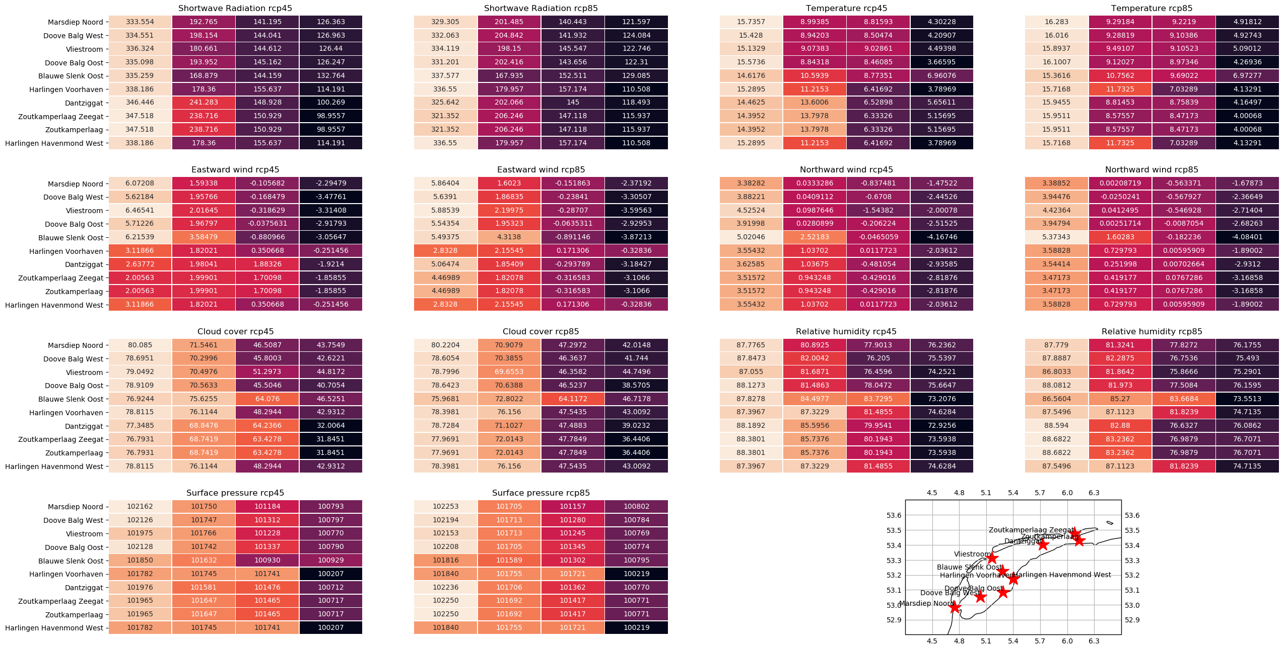
Comparing the different models
In order to analyze the differences between the models, we constructed the 4 clusters for every station, model, and scenario.
These are a lot of numbers for one slide, but the colors are more important: the more the colors vary along one column, the less the models agree.
Models in which there is small variation between the stations are likely to be the more crude ones.
Model 1: CNRM-CERFACS-CNRM-CM5

Slide 8
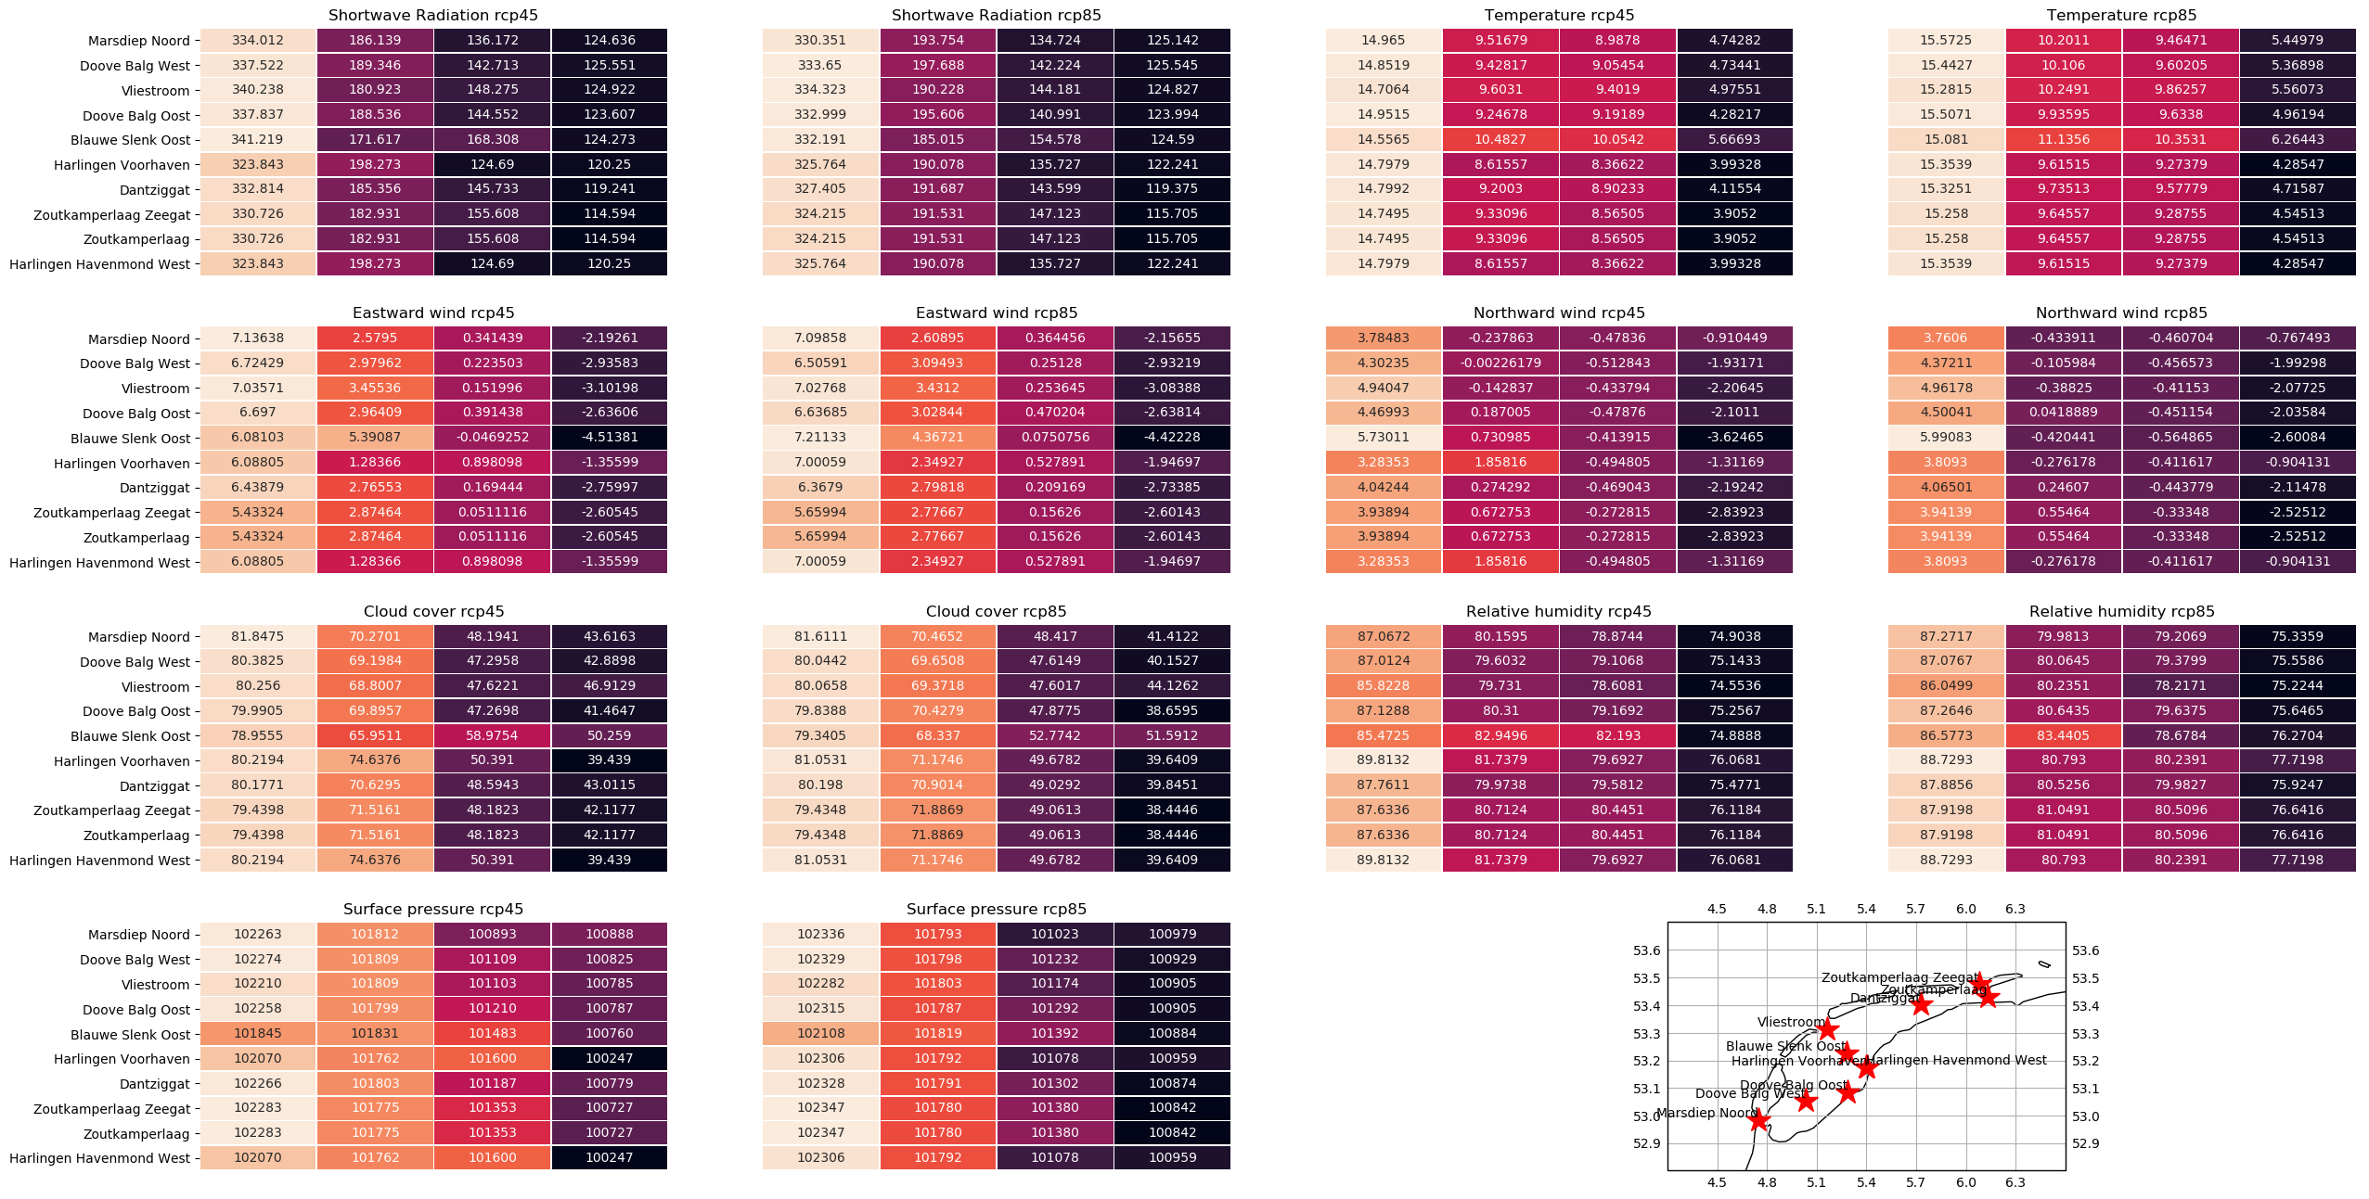
Comparing the different models
In order to analyze the differences between the models, we constructed the 4 clusters for every station, model, and scenario.
These are a lot of numbers for one slide, but the colors are more important: the more the colors vary along one column, the less the models agree.
Model 2: ICHEC-EC-EARTH

Slide 9
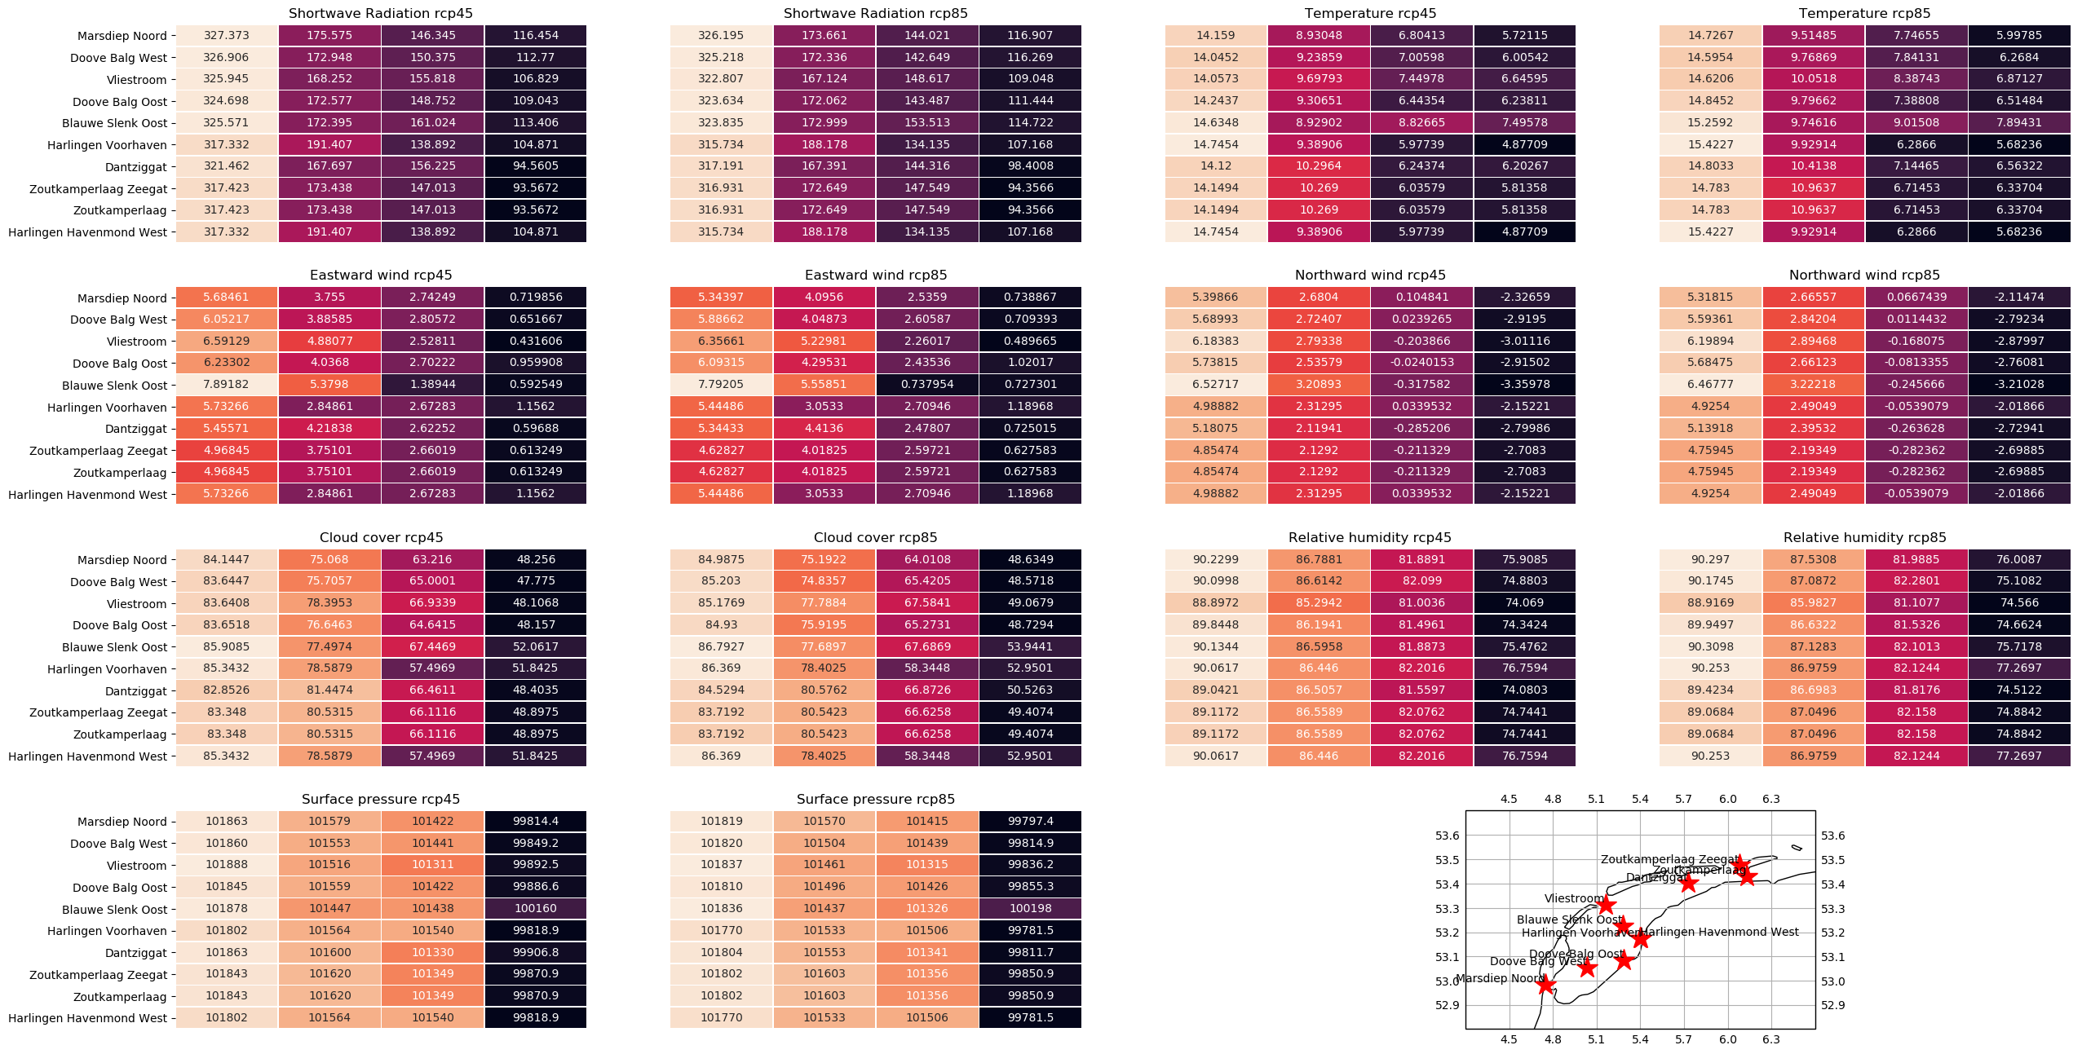
Comparing the different models
In order to analyze the differences between the models, we constructed the 4 clusters for every station, model, and scenario.
These are a lot of numbers for one slide, but the colors are more important: the more the colors vary along one column, the less the models agree.
Model 3: IPSL-IPSL-CM5A-MR

Slide 10
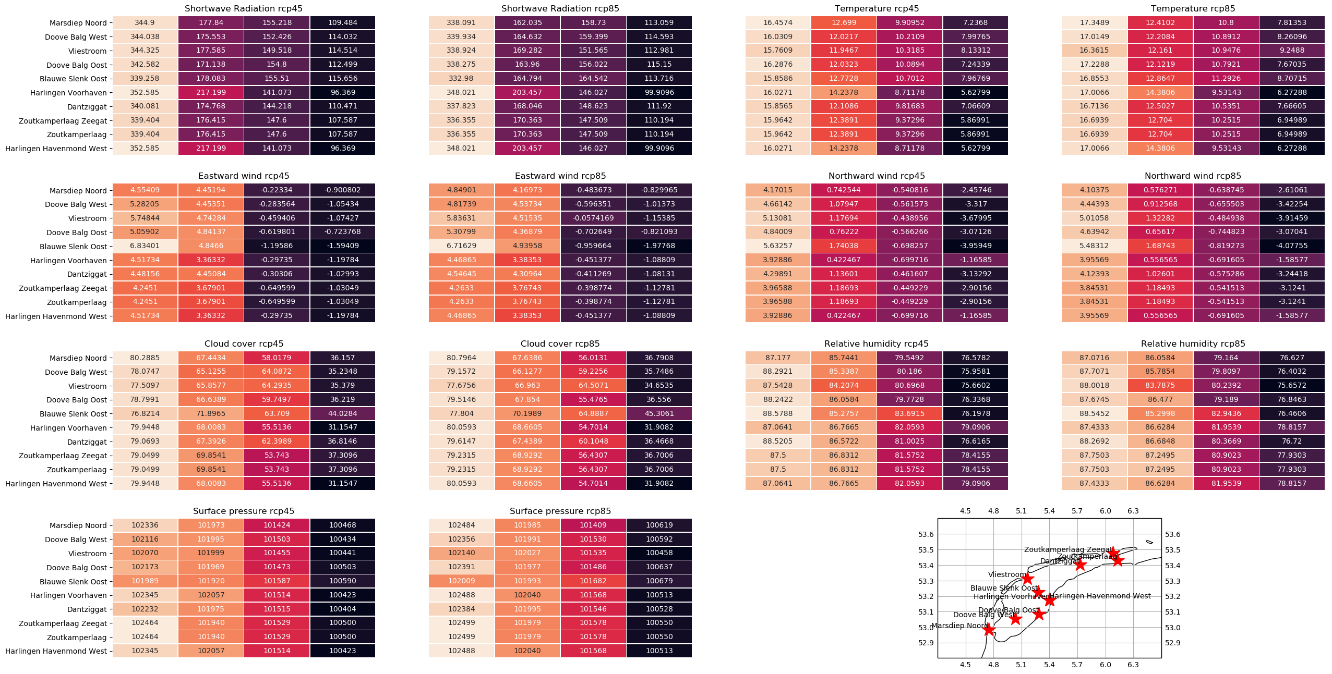
Comparing the different models
In order to analyze the differences between the models, we constructed the 4 clusters for every station, model, and scenario.
These are a lot of numbers for one slide, but the colors are more important: the more the colors vary along one column, the less the models agree.
Model 4: MOHC-HadGEM2-ES

Slide 11
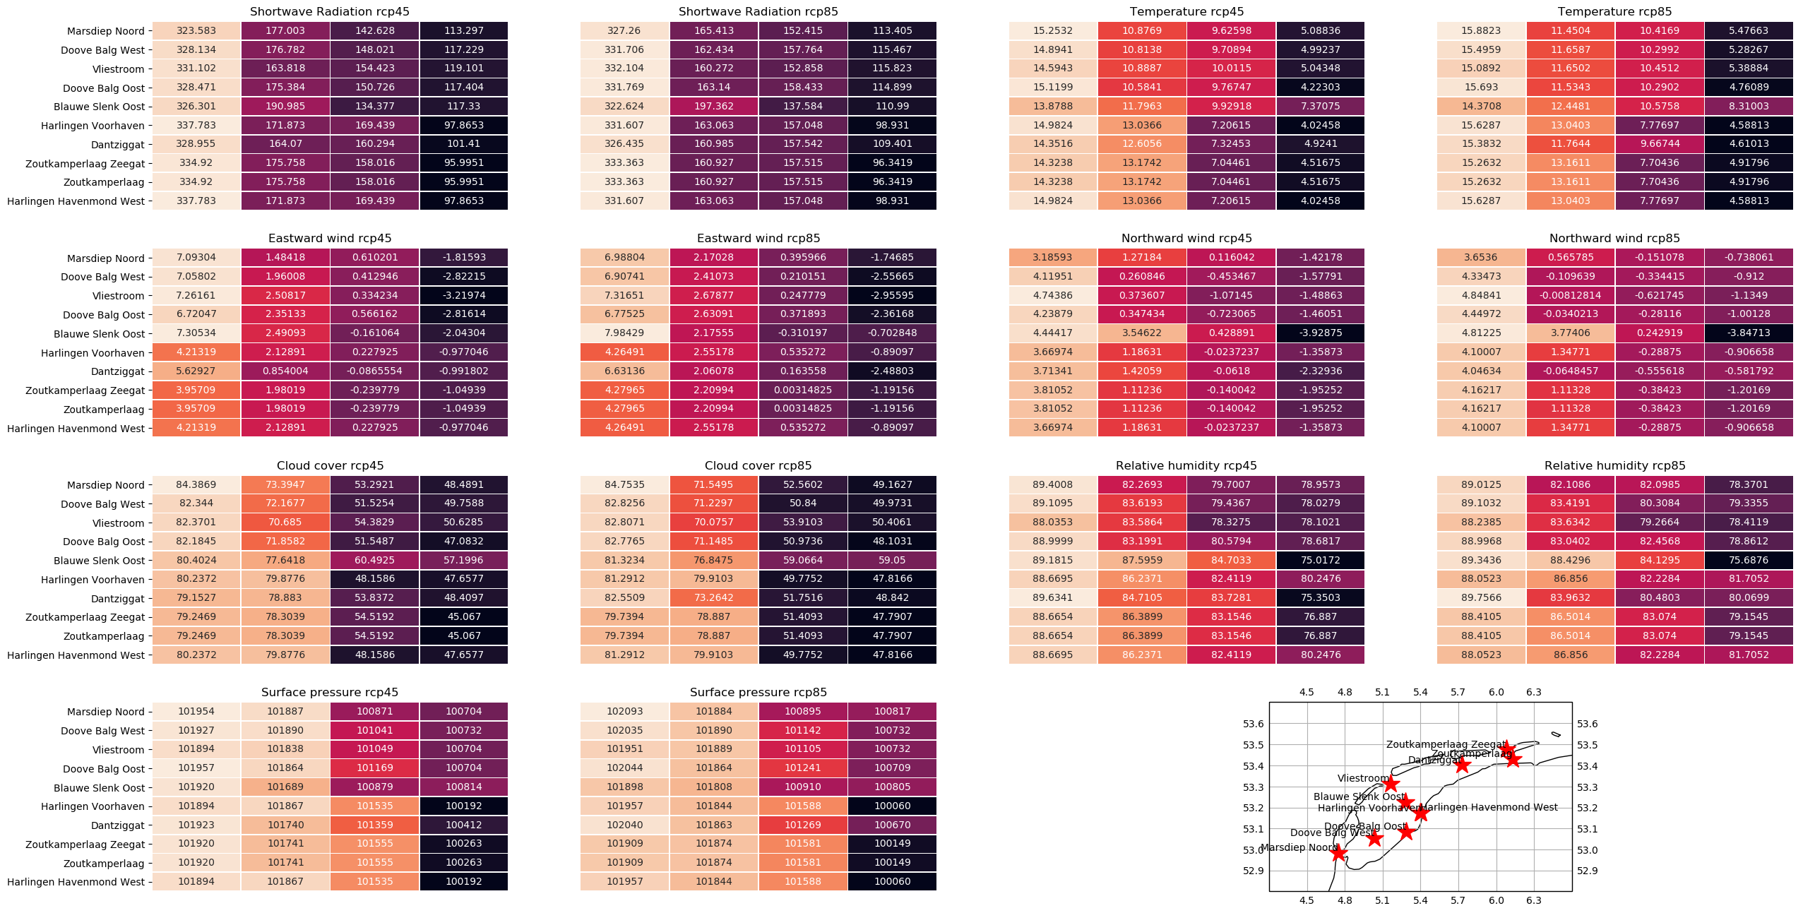
Comparing the different models
In order to analyze the differences between the models, we constructed the 4 clusters for every station, model, and scenario.
These are a lot of numbers for one slide, but the colors are more important: the more the colors vary along one column, the less the models agree.
Model 5: MPI-M-MPI-ESM-LR

Slide 12
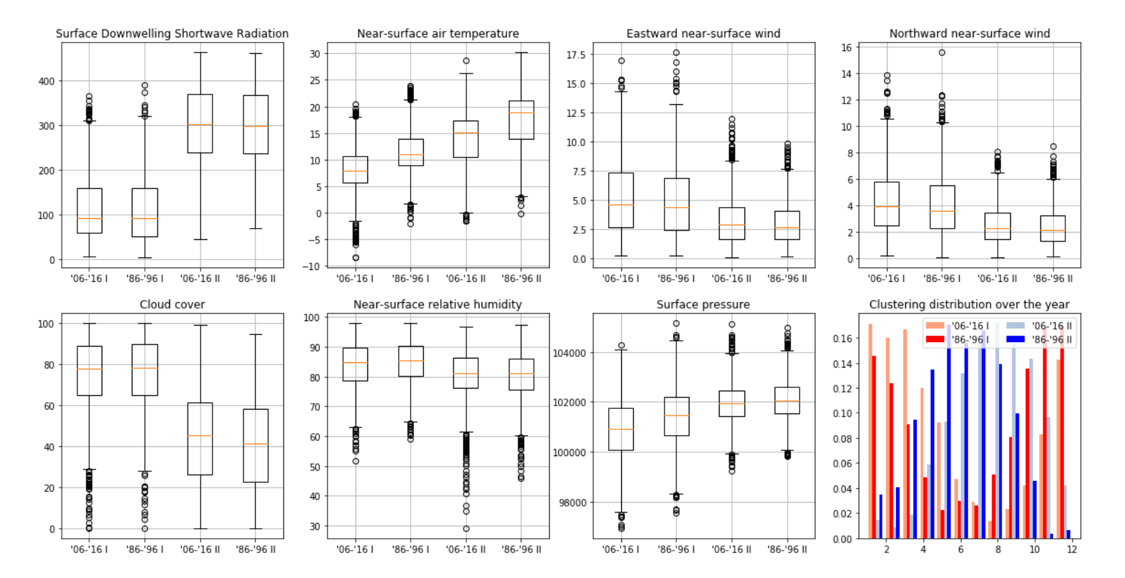
Vizualizing the effects of climate change
In order to use clustering to visualize the effects of climate change, we can compare what happens when you cluster the first and last 10 years, and show the properties of the clusters.
This example shows Marsdiep / MOHC-HadGEM2-ES / RCP8.5.
One can see that although the radiation seems to decrease, the temperature has risen significantly. Also, there seems to be a shift in the seasons: both summer and winter begin and peak earlier. Also, the seasons seem to be more compact.

Slide 13
Clustering final remarks
Conclusions:
The silhouette score agrees with what we have seen in a number of respects, but there is no one-to-one correspondation with the highest silhouette score and the ‘best’ number of clusters.
We can use the tables which compare stations in order to determine the interesting cases as well as conclude the level of detail that each model gives.
When we cluster the first and last ten years, the results provide insight in how climate change affects the location, duration, and properties of the seasons.
To do (when there is time left):
Cluster with some variables left out of the dataset
Implement spatial clustering on the original dataset

Slide 14
Prediction
Currently we have two prediction scenarios:
Predicting a variable from other variables (in a fixed model/station setting)
Predicting all variables of one model from all variables of a different model

Slide 15
Model Prediction: The Deep Learning Approach
For predicting models, we took the Deep learning approach. Let’s call the input model X and the output model Y. We have two different networks set up:
A linearly connected network predicting variables for each day separately. The input is a vector of variables of model X for a specific day and the goal is to output the corresponding vector of variables of model Y for the same day
A sequence to sequence network, consisting of two Long Short Term Memories (LSTMs) stacked together with a final linearly connected layer. The input is a sequence of vectors of model X (e.g. 30 days) and the desired ouput is a sequence of vectors for model Y corresponding to the same dates.

Slide 16
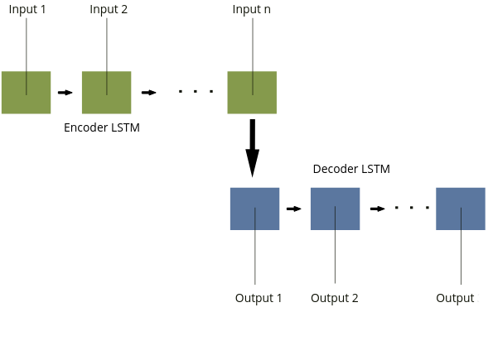
Model Prediction: The Deep Learning Approach
Here is a small sketch of the Seq2seq architecture:

Slide 17
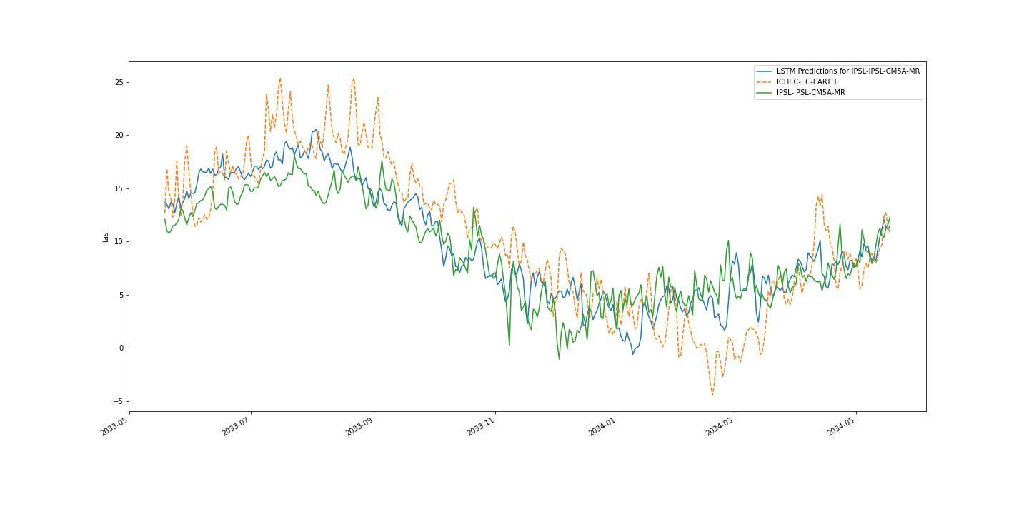
Model Prediction: The Deep Learning Approach
As expected, the LSTMs outperform the linearly connected networks. While the latter does on average converge to a reasonable solution, the per day outputs are highly noisy and do not represent the ground truth. On the other hand, the LSTM does capture the desired sequences fairly well, especially if it is tested on years that are not too far away from the training set. For example, let’s look at predictions of temperature for one of the first years in the test set. Here the input was IHEC-EC-EARTH and the labels from IPSL-IPSL-CM5A-MR

Slide 18
Model Prediction using dense ANN’s final remarks
To do: Generalize this to different models and compare performances as well as to play around with the training set size (e.g. only having the first 100 days poses a bigger challenge since the network never gets to see certain months)
Questions that arise here: How to make the task more challenging? What other predictions could be useful in this context?

Slide 19
Variable Prediction: K-Nearest Neighbours algorithm
One of the methods we used for the predictions is the K-Nearest Neighbour algorithm. In order to predict an arbitrary variable, the other six are used. Implementation:
Analysing the nearest neighbours of the six-dimentional points (corresponding to the six known variables) from the traning set of dimention T
Applying these indeces and distances to the seventh variable

Slide 20
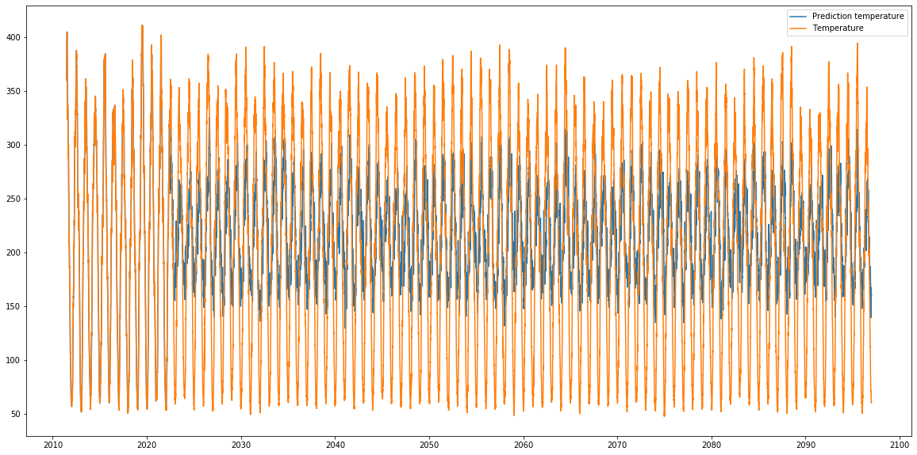
Variable Prediction: K-Nearest Neighbours algorithm
Best performance the variables:
Temperature (figure below)
Surface Radiation

Slide 21
Model Prediction: K-Nearest Neighbours algorithm
Purpose: given all of the variables in one model, predict them for another model
Same procedure as before, this time applied to two seven-dimentional vectors
Low Performance: it seems that this method is not very accurate in model prediction

